Slide 1


New Course Data Flow
Jose Sinclair
Senior Associate Registrar for Operations

Slide 2


Talking Points
  Important Information and Meeting Format
  New Course Data Flow Overview
  DCARS
  Banner
    Timetable Editor/IRIS
    Public & Student Registration Timetable
    ORC/Catalog
    Additional Systems
  Final Questions

Slide 3


Important Information and Meeting Format
DCARS closes Friday, May 29th, 2026.
There are many guides on the Registrar's website with specific, in-depth information. We also offer a Department/Program Administrators Guide, which is an overview document of many of these systems with the intent on being an introductory document for Department Administrators.
There is a moderator who will be taking questions from participants using the ‘raise hand’ feature in Zoom and from chat during presentation.
If we can't get to your questions, or if you have questions that fall outside to scope of this presentation, please email them to registrar@dartmouth.edu.

Slide 4

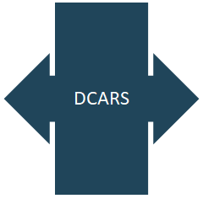
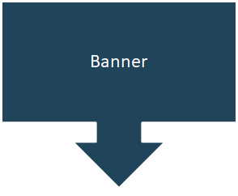
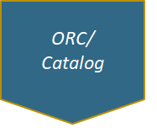
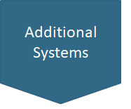
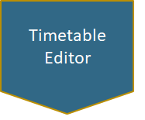
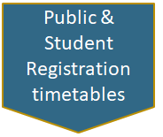
New Course Idea
IRIS

Slide 5
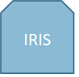
New Course Idea

Slide 6
DCARS
The faculty member or proxy submits the new course information into the Dartmouth Course Approval Routing System (DCARS).
The new course proposal is sent through various faculty committees following the Curricular Guidelines.
Be sure to allow for enough time for faculty committee view and approval prior to the deadlines (see Curricular Deadlines calendar).
Once approved in DCARS the new course is saved in Banner and the ORC/Catalog.

Slide 7
Once information such as Course number, Course title, Course description and Cross-listing information is in Banner, it is distributed to the ORC/Catalog, the ORC New Course Supplement, Timetable, and other consumers.
Banner

Slide 8
Banner
  Teaching schedule data from IRIS is loaded into Timetable Editor
  Updates are made to the schedule of classes in the Timetable Editor manually
  New Courses can be added to the Timetable Editor from Banner
  After the Timetable deadline, the schedule in the Timetable Editor is loaded into Banner
  The term’s schedule of classes is then published from Banner on the Public/Registration Timetables
IRIS
Timetable Editor

Slide 9
Public & Student Registration timetables
After the course schedule is modified in the Timetable Editor it is again saved to Banner and published from Banner to the public and student The Timetable of Class Meetings so students may view and elect courses.

Slide 10
  Nightly data feed of new and updated courses to the draft ORC/Catalog for next year
  New courses also added to current year’s published New Course Supplement
  Edit/update course data in the ORC/Catalog for publication.
    Editing opens during fall term and closes in the middle of summer term
    Data fields that must be updated manually:
      Prerequisite Narratives
      Term Offered (not year or time period)
      Instructor
      Department Specific Categories
    Remove courses that have not been offered in over 4 years.
ORC/Catalog

Slide 11
Additional Systems
  DartWorks Planner
  Canvas
  Data Warehouse
  Course Assessment

Slide 12

Questions?

Slide 13
Thank You

