Slide 1

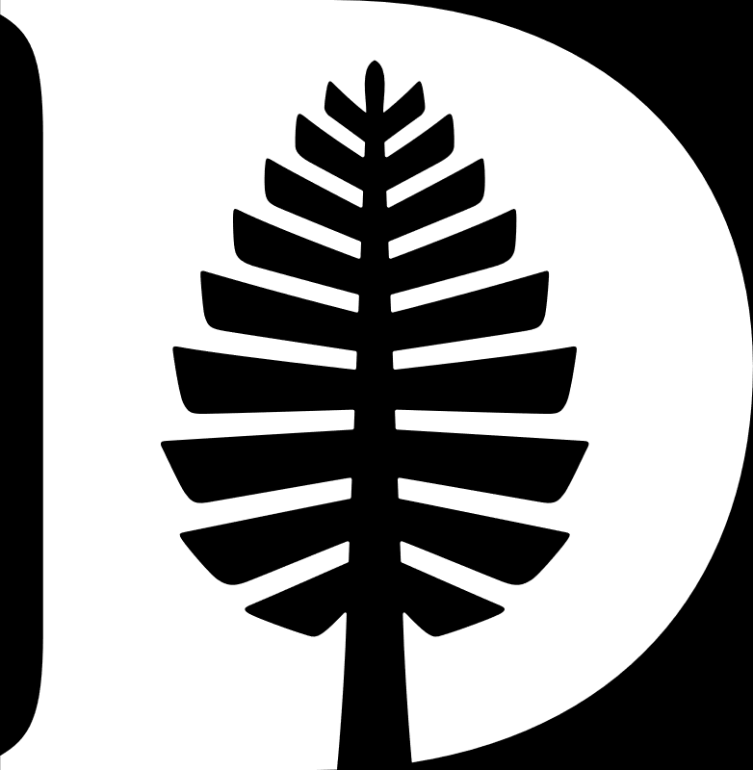
Timetable Editor Application
Catherine Woodard
Assistant Registrar for Curriculum,
Course Management, and Operations

Slide 2

Talking Points
  Important Information and Meeting Format
  Department/Program Timetable Editor Overview
  Helpful Basics
  Adding a Course
  Required Course Information
  Additional Fields
  Textbook Tool
  IP Course Manager
  Timetable Editor Reports
  Common Errors/Special Mentions
  Final Questions

Slide 3



Important Information and Meeting Format
Timetable Editor submission deadline for Winter 2026 is October 23. Spring 2026 is February 5.
There are many guides on the Registrar's website with specific, in-depth information. We also offer a Department/Program Administrators Guide, which is an overview document of many of these systems with the intent on being an introductory document for DPAs.
There is a moderator who will be taking questions from participants using the ‘raise hand’ feature in Zoom and from chat during presentation.
There will be a few question breaks interspersed throughout the presentation and time for questions at the end.
If we can't get to your questions, or if you have questions that fall outside to scope of this presentation, please email them to registrar@dartmouth.edu.

Slide 4
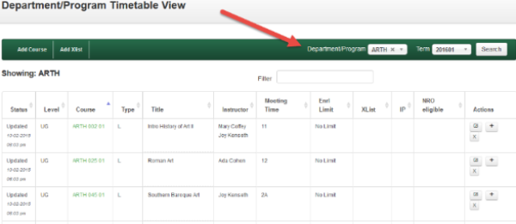

Department/Program Timetable Editor Overview
Direct link: http://timetable.dartmouth.edu | From Banner for Faculty: https://www.dartmouth.edu/bannerstudent
The Editor is term-based; use the term selector plus SEARCH button to switch between terms. The layout is similar to the Public Timetable, and course section information that is not visible in the MAIN view is visible once you begin to edit.
The Department/Program selector allows you to view your own Department/Program by default. To view courses in another Department/Program, select it from the drop-down menu. Course information on the Timetable Editor is imported from IRIS after it is provided to the Dean of Faculty by each Department/Program.
The layout is similar to the Public Timetable – Once you click EDIT to open up a course information that is not visible in the MAIN layout will be visible at the section level.
The main screen: this is a view of all the Department's/Program's courses for a given term.

Slide 5
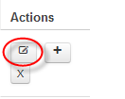

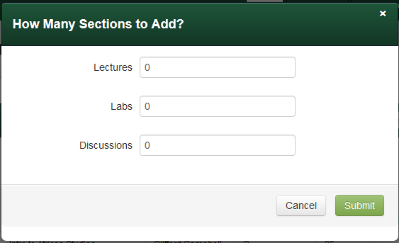
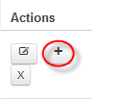
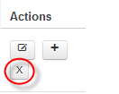
Helpful Basics
Icons
On the far right-hand side of the MAIN view is the Actions column, which contains the control icons: Edit Section, Copy Section, and Delete Section.
Status
The far left-hand column displays the current status of the section. This describes where it is in the editing process – created, updated (with date-stamp), or approved.
Edit Section opens a course section for editing –
this is where most of your work will take place
Copy Section opens a dialog box to add further sections to a course; for example extra lectures for ECON 001 or SPAN 002, or extra lab sections for CHEM 006. All types of sections may be added: lectures, discussions, and laboratory sections.
Updated indicates that you have edited the record,
which is also recorded by the date stamp.
Created indicates that the course has been loaded
to the Editor, but has not yet been edited.
Delete Section removes the record of that course. If you delete something in error, you can always add it back using the Add Course function.

Slide 6


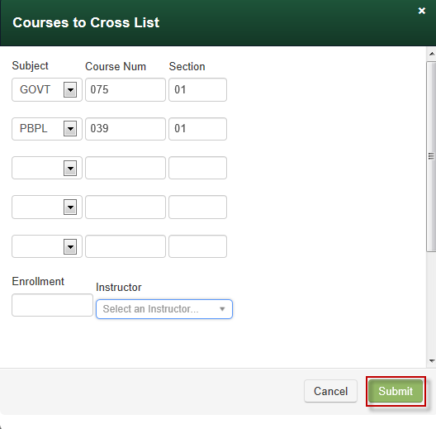
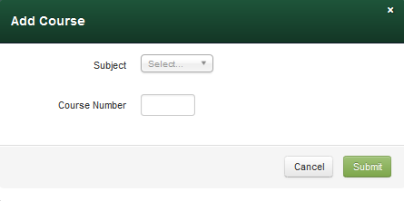
Adding a Course
Add Course allows you to add any course that has a valid Banner Catalog entry. The button opens a dialog box where you select a subject and course number, and SUBMIT. That triggers a check in Banner, and when the window disappears, you see a message below the header bar that indicates either a successful addition of a course, or that the course is not in Banner.
Add Xlist allows you to add new cross-lists that were not included in the original course information received from the Dean of the Faculty Office. Select the subject/course number/section combinations necessary for a cross-list, add the total overall enrollment limit, if any, and the instructor, then click SUBMIT. If all the sections are in Banner, they will be added to the MAIN view for further editing.
If you are adding multiple sections
of a cross-list, you will add them
one at a time and change the section
numbers here (“02, 03, etc.”).
NOTE: If you edit one section of a cross-listed course, the edits are also made to all other sections of the course. Therefore, you do not have to maintain the data multiple times. Courses must be shown as cross-listed in the Timetable Editor for these edits to be reflected in cross-listed sections.

Slide 7

Questions?

Slide 8
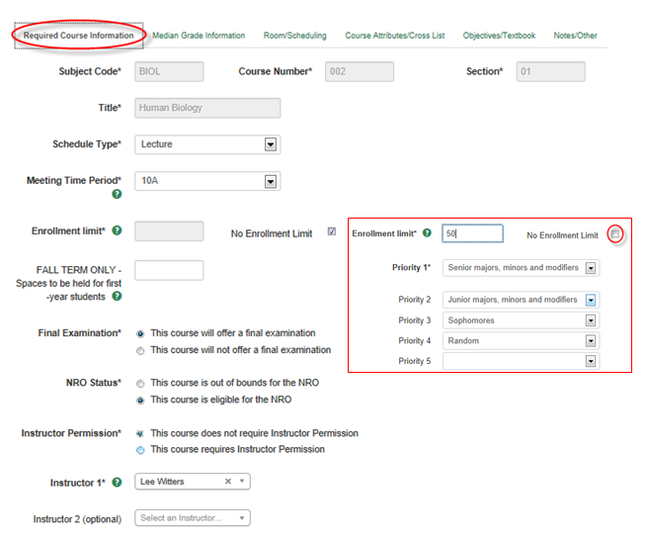
Required Course
Information
This tab is where you set the meeting time and confirm various setup options (IP, NRO changes, Credit/No Credit), enrollment limits, and priorities. All data marked by BOLD type and an asterisk is required – you may not save a course without first entering that information. All required information is on this tab.
Once a course has data in the Editor for a term, the enrollment and priorities information on this tab will roll over into new terms.
For courses with multiple Schedule Types (Lecture, Lab, Discussion), the field will default to “Lecture.” When adding Lab or Discussion sections, this field should be changed for that section. Only approved Schedule Types will appear in the drop-down field.
NOTE: The priorities selection tool will appear once you uncheck the No Enrollment Limit box. As you begin to select your course's priorities, more rows will appear. Selecting RANDOM will end a set of priorities. You can change priorities by simply selecting a different category, and erase one by selecting the blank row in the dropdown. You only need to enter as many priorities as your course requires – the Editor provides space for up to 13 selections (including Random). Note that priorities only determine the order in which student groups are enrolled into a course when course elections are processed. It does not prevent students in other groups from enrolling if there are spaces remaining and is not used during the course change or add/drop periods.

Slide 9
Questions?

Slide 10
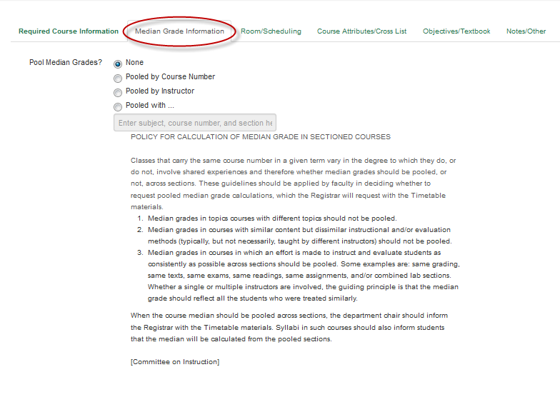
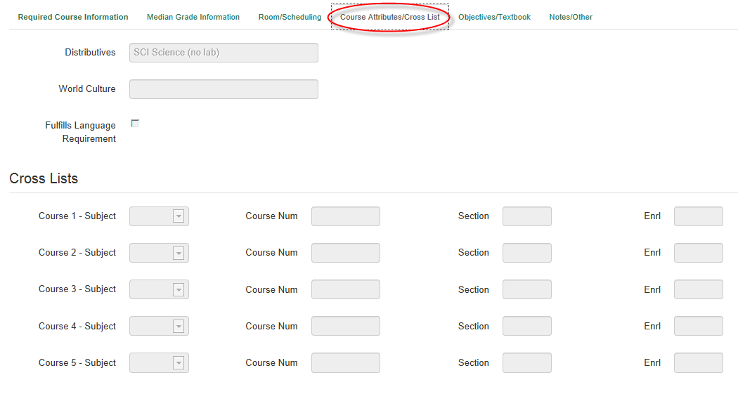
Additional Fields
Median Grade Information
Course Attributes/Cross-List
Use this tab to select any custom median grade pooling requirements your course(s) may have. NOTE: All cross-listed courses are automatically pooled; ECON courses are pooled by course and instructor; MATH courses are pooled by course number. This tab is optional – please make a selection here ONLY if your Department/Program requires a specific median grade pooling (for example, PHYS 14 sections 1 and 2).
Review the distributive/world culture assignments for the course, as well as the cross-listing information if there is any. No edits are possible here for cross-listed courses – those are made at each individual section level. To ensure this information is accurately reflected in reporting, this tab should be viewed at least once every term when setting up your timetable each term for every course.

Slide 11
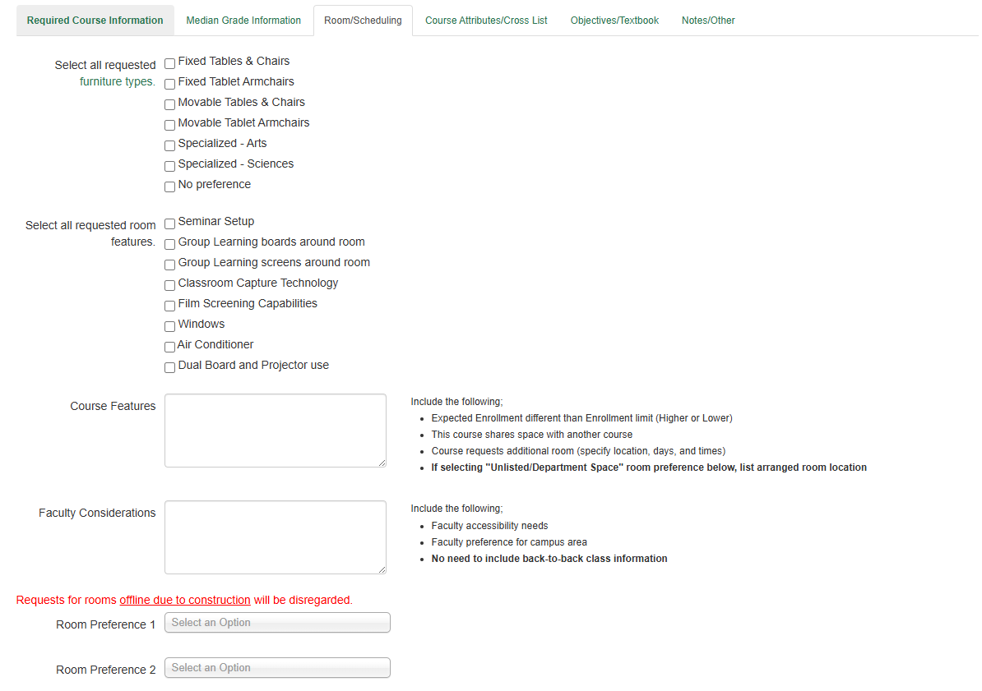
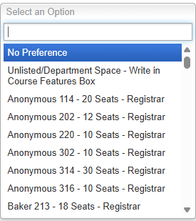
Additional Fields
Room/Scheduling
Furniture Types
Select all types of requested furniture – view link for details
Room Features
Select tech and physical feature requests
Course Features
Share info pertinent to scheduling including expected enrollment, sharing space, extra room requests, etc.
Faculty Considerations
Share faculty room preferences and needs
Room Requests
View CRR offline rooms, and consider room size and manager
If selecting ‘Unlisted/Department Space’, fill in room number in Course Features box
Notes:
Furniture Types: can make multiple selections and click on an item to get more information; avoid selecting furniture types and room preferences that do not match the selected classroom, such as movable tables in an auditorium
Room Features: can make multiple selections; use the selection buttons to show preferences rather than the Course Features text box
Course Features: more specific requests or information to provide Registrar’s office, such as an unlisted room, higher/lower expected enrollment, shared space with another course
Faculty Considerations: accessibility needs or other faculty preferences; do not repeat information found in other areas
Rapid Refresh Link: review information on which classrooms are offline or going offline before selecting a room preference
Room Requests: select which rooms you’d prefer; you can pick another departments room, but the chance of getting the room is lower and should be discussed with that department before selecting it as an option
Information is no longer auto populated from previous terms; it must be filled out each time. The Registrar’s office is collecting data on how many people get their classroom choices to help improve the process

Slide 12
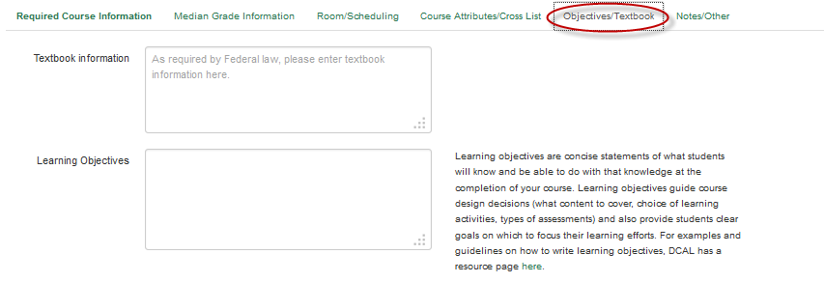
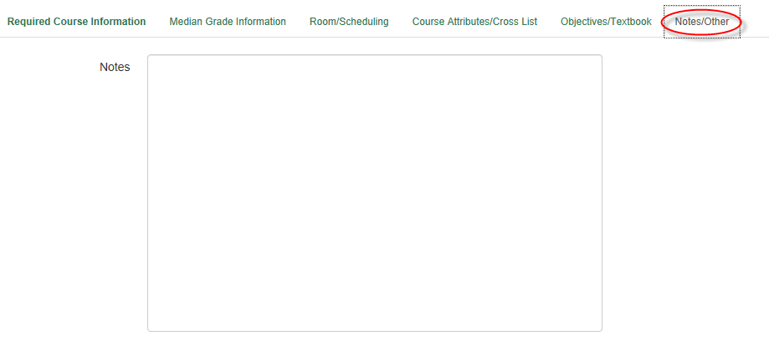
Additional Fields
Objectives/Textbook
Notes/Other
Enter the course's Federally-required textbook information as well as the course's Learning Objectives, which are optional.
This is a free-form data entry area for Department/Program use only that can be used for anything – update notes between a Department/Program administrator and a Chair; change notations for courses; or anything else that may be of use to record within your Department/Program.

Slide 13
Questions?

Slide 14
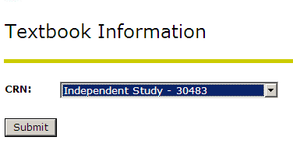
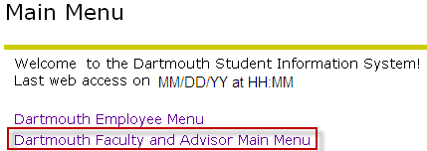
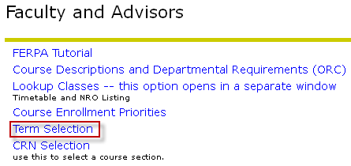
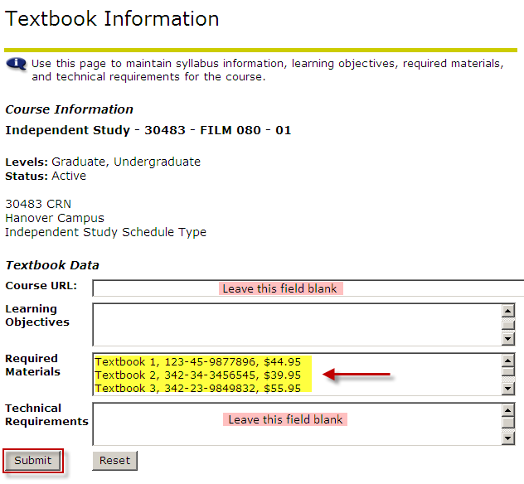
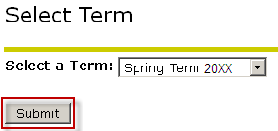
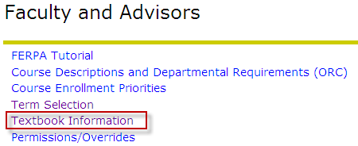
Textbook Tool
Step 5: Select the course for which you intend to enter textbook information
Step 1: Access Banner and click on Faculty and Advisor Main Menu
Step 2: Click on Term Selection to select the proper term
Step 6: Enter textbook information in the 'Required Materials' field.
Textbook ISBN and list price are mandatory. Textbook title and author are optional. Please note: Required Materials field will accept plain text, quotes around text title, dollar sign in front of price, and carriage returns (when more than one book is required). The 'Course URL,' 'Learning Objectives,' and 'Technical Requirements' fields are all currently inactive – please do not enter any information into these fields.
If you are entering information for multiple textbooks, you only need to do this once at the start of your session. You will remain in this term until you change the selection.
Step 3: Select the proper term
Step 4: From the Faculty and Advisor Menu, click on Textbook Information

Slide 15
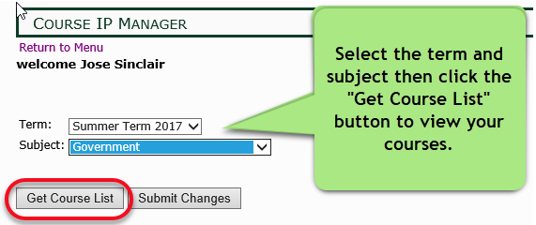
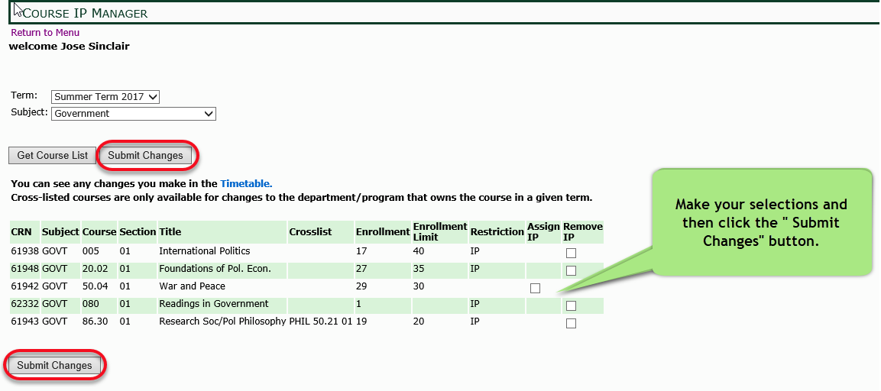
IP Course Manager
From the day before the course change period through the add/drop period, you may use the IP Course Manager to add or remove IPs from courses. Prior to these dates, you may contact the Registrar’s Office for Assistance.
Note: Once a course has been published to the Timetable of Class Meetings, edits made to the course in Timetable Editor will not be made to the published course.
Log in to Banner, and select “Course IP Manager” from the Faculty and Advisor main menu.

Slide 16
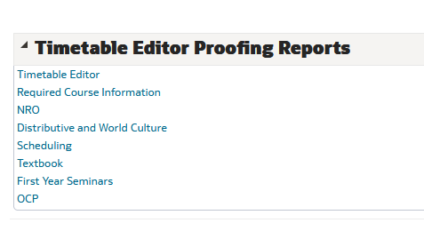
Timetable Editor Reports
IRA Warehouse: https://ira.dartmouth.edu/analytics/

Slide 17
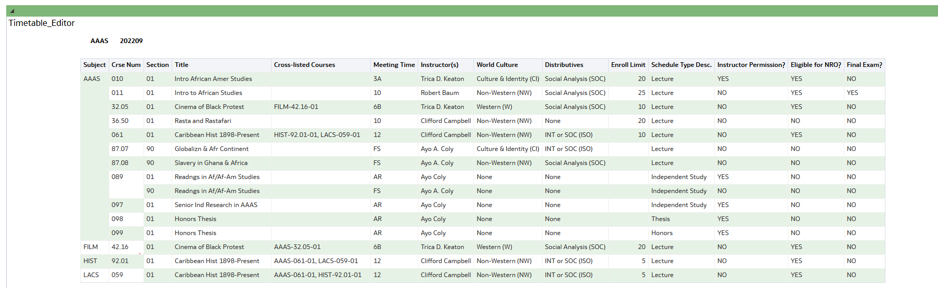
Timetable Editor Reports

Slide 18
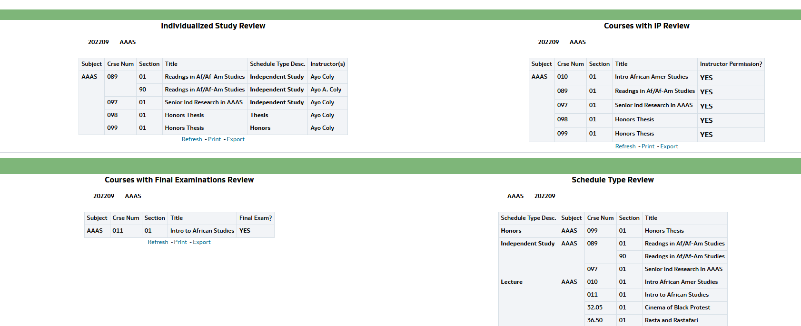
Timetable Editor Reports
Required Course Information

Slide 19
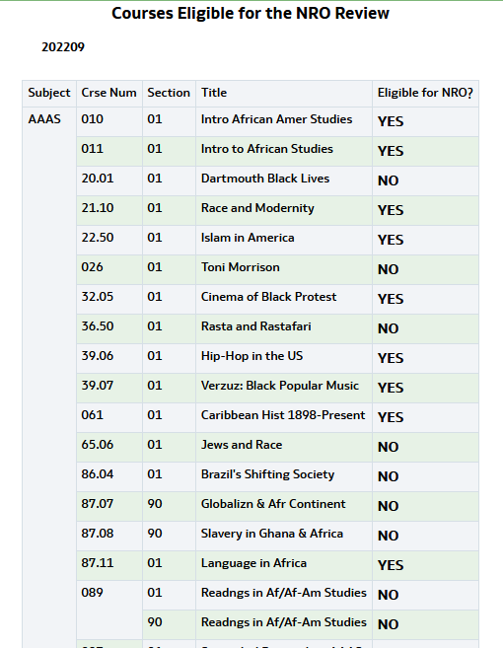
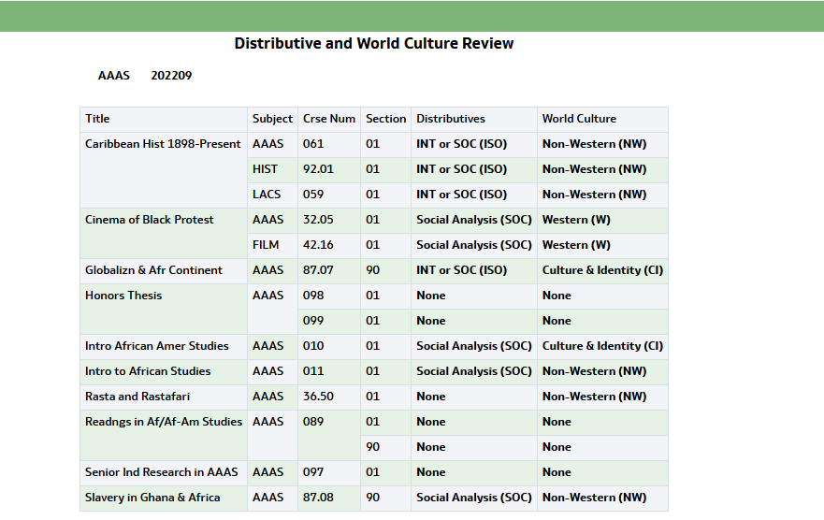
Timetable Editor Reports
NRO and Distributive and World Culture

Slide 20
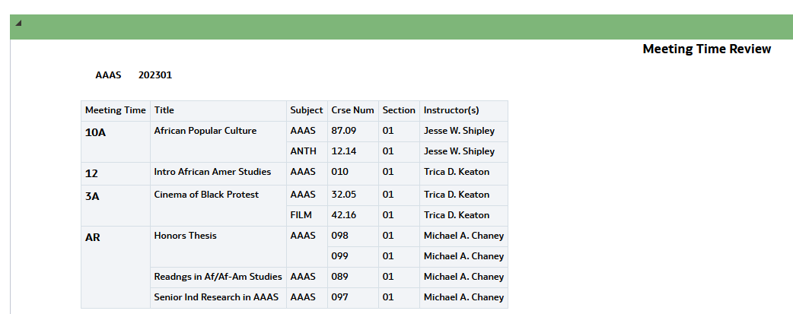
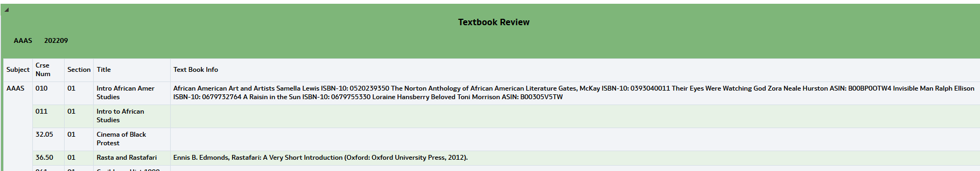
Timetable Editor Reports
Scheduling and Textbook

Slide 21
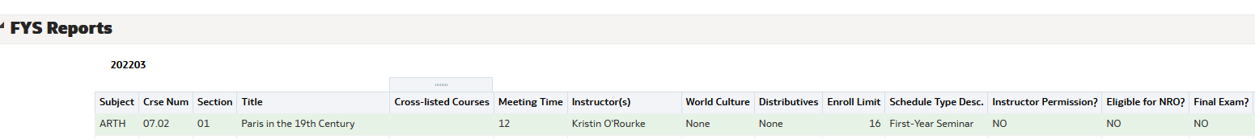
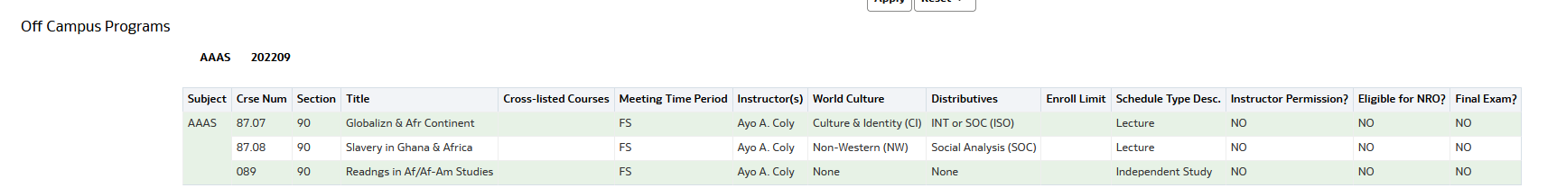
Timetable Editor Reports
First Year Seminars and OCP

Slide 22
Questions?

Slide 23
Common Errors
Special Mentions
Error: Incorrect information from IRIS
  What to look for: Cross-lists that don’t exist, old course numbers
  How to fix: Remove from the Timetable Editor and add a new entry
Error: The Timetable Editor does not recognize a course number
  What to look for: Receiving an error when trying to add an existing course or cross-list
  How to fix: Confirm that the correct number format is being used. Ex: 023 instead of 23, or 08.10 instead of 8.1
Error: Course is published as Credit/No-Credit
  What to look for: The CT/NC box is checked in the Timetable Editor
  How to fix: Uncheck the CT/NC box
  Off Campus Programming (LSA/FSP)
    Required to have: Section 90s, instructor name, Meeting Time Period. May not have enrollment limits or an IP
    Need help? Email Registrar’s Office for help renumbering course sections. You may wish to coordinate with the Guarini Institute to make sure their website reflects your planned offerings
    Courses published after Timetable deadline/course data that needs changing
    Add course to the Timetable Editor and let the Registrar’s Office know
      If there is heavy demand for classrooms during a popular time period, there may not be room for additional courses. Reach out to the Registrar’s Office with desired time period, enrollment limits, and any desired classroom space with more information.
    Course changes
      Course names, descriptions, NRO-status, grading method: may not be changed after publication.
      To raise enrollment limit: submit request to Registrar’s Office. To lower enrollment limit, you must first receive approval from the Associate Deans.
      Time change: Instructor and/or chair may submit request to Registrar’s Office for consideration and next steps.
      Distributives: If no distributives/world cultures exist, a DCARS proposal may be submitted.
      Language Requirements: Reach out to the Registrar’s Office to enquire.

Slide 24
Questions?

